Slide 1


Logical reasoning
1

Slide 2
A Restaurant Scenario
In a restaurant, your Father has ordered Fish, your Mother ordered Vegetarian, and you ordered Meat.
Out of the kitchen comes some new person carrying the three plates.
What will happen?
  The waiter asks a first question, say “Who ordered the meat?”, and puts that plate.
  Then he asks a second question “Who has the fish?”, and puts that plate.
  And then, without asking further, he knows he has to put the remaining plate in front of your Mother.
    What has happened here? …

Slide 3
How was the Conclusion reached?
Starting at the end, when the waiter puts the third plate without asking, you see a major logical act
The information in the two answers received allows the waiter to infer automatically where the third dish must go.
The waiter draws a conclusion.
We represent this in an inference schema with some notation
  (F for “fish”, M for “meat”,V for “vegetarian”)
  F or V or M
  not M
  not F
→V
Logic can be seen in action all around us

Slide 4
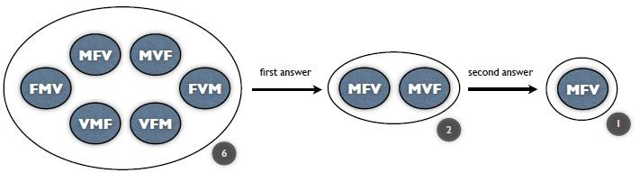
Formally stating the procedure, we have
The Restaurant scenario starts with an initial information state
consisting of six options
  all the ways in which three plates can be distributed over three people
  (MFV;MV F;FMV;FVM;VMF;VFM).
The answer to the first question then reduces this to two
  (the remaining orders FV ,V F)
The answer to the second question reduces this to one
  ( the one remaining V)
MFV .

Slide 5
Reasoning
Drawing of inferences or conclusions from known or assumed facts
The act of inference
Drawing conclusion from two pieces of information
Why is reasoning important?
When solving a problem:
one must understand the question
gather all pertinent facts
analyze the problem
and then come out with a correct strategy to solve the problem………………
We need the skill of correct reasoning.
  Logic – The science of correct reasoning.

Slide 6
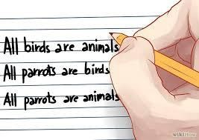
Identifying facts and conclusion
6
Department of CSE

Slide 7

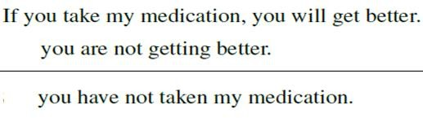

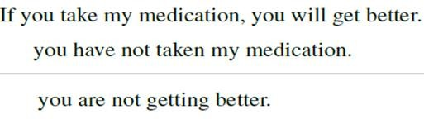

Identifying facts and conclusion
Doctor to patient:-
If you take my medication, you will get better.
You have not taken my medication.You are not getting any better.
The two facts
Option 1
Conclusion
The two facts
Option 2
Conclusion

Slide 8
Identify facts and conclusion for the sentences given below:-
If Joe has acute appendicitis, he is very sick. Joe does have acute appendicitis.Therefore he is very sick.
During the weekend we either go fishing or we play cards. This weekend
we did not go fishing.Therefore, this weekend we were playing cards.
3. If we win the If we have money
game we will we will go on
get much a trip to
money. China.
Therefore, if we win the game we will go on a trip to China
8
Department of CSE

Slide 9
Identify facts and conclusion (Soln.)
Fact 1: If Joe has acute appendicitis, he is very sick. Fact 2: Joe does have acute appendicitis. Conclusion: Joe is very sick.
Fact 1: During the weekend we either go fishing or we play cards. Fact 2:This weekend we did not go fishing.
Conclusion :This weekend we were playing cards.
3. Fact 1: If we win the game we will get much Fact 2: If we have money we will go on a trip to China.
Conclusion : If we win the game, we will go on a trip to China.
money.
9
Department of CSE

Slide 10
What will be the conclusion for cases given below?
Set 1:-
Fact 1: Islands are surrounded by water. Fact 2: Maui is an island.
Set 2:-
Fact1: Acute angles are less than 90 degrees Fact2 :This angle is 40 degrees
10
Department of CSE

Slide 11
What will be the conclusion for cases given below?(Soln.)
Set 1:-
Fact 1: Islands are surrounded by water. Fact 2: Maui is an island.
Conclusion: Maui is surrounded by water.
Set 2:-
Fact1: Acute angles are less than 90 degrees Fact2 :This angle is 40 degrees.
Conclusion: It is an acute angle.
11
Department of CSE

Slide 12
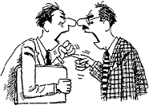

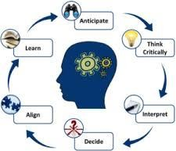
Arguments
In day-to-day life “arguing” is usually understood to mean a disagreement or fight,
and something that most try to avoid
An Argument --- could be a collection of conversation which helps us draw some conclusion
Arguments are part of thinking processes
Arguments are a part of how we use logical reasoning
Formally, argument is a group of statements, where the conclusion statement is claimed to follow from the other statements.
Arguments can be either inductive or deductive.

Slide 13
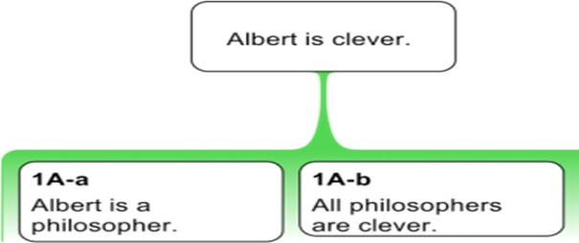
Structure for a logical argument
This is my conclusion (or claim), it’s what I am trying to prove
Here is one premise ( fact #1) that backs up my claim
Here is another premise ( fact #2) that backs up my claim

Slide 14
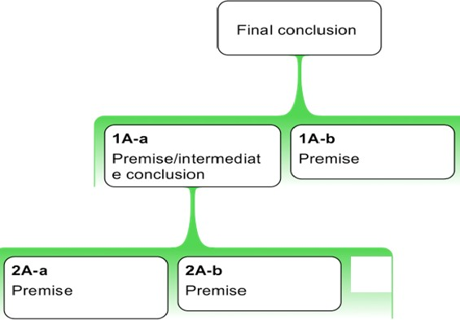
In logic, an argument requires
  a set of (at least) two declarative sentences (or “propositions”) known as the premises
  along with another declarative sentence (or “proposition”) known as the conclusion

Slide 15
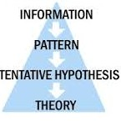
Deductive reasoning
Deductive reasoning that is based on a general statement of fact is hard to argue with
When using this method, you begin with a factual statement
  Eg: a class of things, such as animals
For example, you might say, “all animals need oxygen”
Because this is true of every animal, it is true of each animal as well.
Therefore, you can truthfully conclude that a specific animal, like
your pet tommy, needs oxygen
It is also called top-down logic

Slide 16



Deductive reasoning- example
“All green plants need sunlight.”
  It starts off with a general statement
Known Fact #1
“This rosebush is a green plant.”
  The next step is reducing the general
to a particular example
Known Fact #2
“Therefore, this rosebush needs sunlight.”
  Finally, you draw a conclusion
Conclusion

Slide 17
Another example
Known Fact #1
The cut-off date for swim camp registration is June 15
After that date, kids go on a wait list - no exceptions allowed
Known Fact #2
You have missed the cut-off to date to register your child by two days
Conclusion
Your child won’t be registered and her name will go on the wait list
What do all these examples tell you?
  Deductive reasoning drives you to a conclusion based on known facts

Slide 18

Advertisements and commercials –an example
Man: What’s better, faster or slower?
All kids: Faster!
Man: And what’s fast?
Boy: My mom’s car and a cheetah.
Girl: A space ship. Man: And what’s slow? Boy: My grandma’s slow.

Slide 19

Man: Would you like her better if she was fast?
Boy: I bet she would like it if she was fast.
Man: Hmm, maybe give her some turbo boosters?
Boy: Or tape a cheetah to her back.
Man: Tape a cheetah to her back, it seems like you’ve thought about this before.
Narrator
It’s not complicated, faster is better.
And iPhone 5 downloads fastest on AT&T 4G.
What do you think this Ad conveys to the viewers?
The viewer is left with what conclusion?

Slide 20

Deductive reasoning applies a general rule to specific examples
This can be seen in advertisements like the AT&T commercial
The kids establish in their conversation that faster things are better
The narrator says that iPhone 5 downloads fastest on AT&T 4G
Thus the viewer is left with the conclusion that AT&T 4G is better
This commercial’s deduction can be summed up as follows
  Faster things are better
  AT&T 4G is faster
AT&T 4G is better
Deductive Reasoning

Slide 21
A conversation
John:- Hello Peter.What have you been doing with yourself lately? Peter:- Not much as am busy with work, but I have started exercising. John:-Ohh, are you trying to get in shape?
Peter:- Not really as I am quite trim at the moment, I just want to improve my health.
John:- Yes, that is a good idea I need too as well.What are you doing?
Peter:- I am going to the gym and do weights and running on the treadmill. John:- I also think that I need to eat better, it will also help me keep in shape. Peter:- Did you know that sleep is good for your health. I have heard that people who sleep on average of eight hours a day will have less health problems.
John:- That's is good there are a lot of things we can do to stay healthy. Peter:-Yes. But It will be worth it in the long run.When you get old, it is important to be healthy and active.
What are the facts?
What is the conclusion?
21
Department of CSE

Slide 22
Facts and Conclusions
Facts:-
Peter started exercising
He is doing to improve health
He is going to the gym and do weights and running on the treadmill
He thinks sleeping is also good for health
He wants to be healthy and active when he is old
Conclusion:-
Peter is doing exercise so that he can be healthy when he is old
22
Department of CSE

Slide 23
Write the conclusion for the following
Premise: All mammals are warm-blooded animals.
Premise: No lizards are warm-blooded animals.
Conclusion:
Premise: All humans are mortal.
Premise: All Greeks are human.
Conclusion:
Premise: Existence has be true if one is thinking.
Premise: I am thinking.
Conclusion:
23
Department of CSE

Slide 24
Major Premise: All mammals are warm-blooded animals.
Minor Premise: No lizards are warm-blooded animals.
Conclusion: Therefore, no lizards are mammals.
Correct Syllogism:
Major Premise: All humans are mortal.
Minor Premise: All Greeks are human.
Conclusion: Therefore, all Greeks are mortal.
Descartes’ Syllogism (correct)
Major Premise: Existence has be true if one is thinking.
Minor Premise: I am thinking.
Conclusion: I think, therefore, I am.
24
Department of CSE

Slide 25
A valid deductive argument
Known Fact #1
All humans are mortal
Known Fact #2
John Smith is human
Conclusion
Therefore, John Smith is mortal
The conclusion is necessarily drawn from the premises.
If the truth of the premises ( #1 and #2) is admitted, then the conclusion
“John Smith is moral” must also be admitted as true.
This is a simple valid deductive argument because the conclusion is necessarily drawn from the premises

Slide 26

Caution
When the reasoning is faulty, deduction is
open to debate…..
All cats are females
This Jerry is a cat
Therefore, this Jerry is a female
Can you spot the flaw in the reasoning?
Clearly, some cats are females but not all cats.
You cannot reason that a particular Jerry cat is a female based on your faulty generalization

Slide 27
A not necessarily valid deductive argument
Dogs are ill-behaved
All dogs are animals
Therefore, all animals are ill-behaved
It appears the same as the one previously written…..
Experience tells us that there are animals that are not ill-behaved
The conclusion is wrong
This is an invalid deductive argument

Slide 28

When are conclusions false?
Deductive reasoning does not grant new knowledge
Instead, it clarifies concepts that we may already know something about
Deduction aims at producing true, valid conclusions only based on prior knowledge of the truth of its facts
If one of the facts is false,
the conclusion will be false
✓

Slide 29
The success of deductive reasoning depends upon the truth of your premise
A premise (a declarative sentence) is the basis for an argument

Slide 30


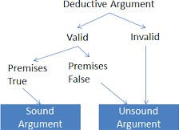
30
Department of C
SE

Slide 31
Valid argument
All cats are animals. If this premise is true…
This Jerry is a cat.
Therefore, this Jerry is an animal.
It is impossible for this conclusion to be false.
Thus, we have a valid argument.
  When it’s not possible for the premise to be true and the conclusion to be false, you are looking at a valid argument

Slide 32


Sound argument
All cats are females
This premise is not true, thus we don’t have a sound argument
This Jerry is a cat
Therefore, this Jerry is a female
All cats are animals
This premise is true, so we are able to build a valid argument to prove a conclusion
This tabby is a cat
Therefore, this tabby is an animal
  When you have a true premise, you have the foundation for a sound argument

Slide 33
Look at the examples below and decide whether they are sound deductions.
All first-graders are 6 years old.
My cousin is a first-grader.
Therefore, my cousin is 6 years old.
All first-graders at Roosevelt Elementary take Spanish.
Josh is a first-grader at Roosevelt Elementary.
Therefore, Josh takes Spanish.

Slide 34
Check whether the conclusions in each scenario is valid or not
No one who can afford health insurance is unemployed. All politicians can afford health insurance. Therefore, no politician is unemployed.
Some professors wear glasses. Mr. Einstein wears glasses. Therefore, Mr. Einstein is a professor.
Solutions:-
Valid
Invalid
34
Department of CSE

Slide 35
Correct it the following arguments if necessary.
Argument One
Major Premise: When it snows the streets get wet.
Minor Premise: The streets are getting wet.
Conclusion: Therefore, it is snowing.
Argument Two
Major Premise: If you buy a Ferrari, you will instantly be popular.
Minor Premise: Ed just bought a Ferrari.
Conclusion: Ed will achieve instant popularity.
35
Department of CSE

Slide 36
Argument Three
Major Premise: When the battery is dead, the car will not start.
Minor Premise: The car will not start.
Conclusion: Therefore, the battery is dead.

Slide 37
Solution
One:
Major Premise: When it snows, the streets get wet.
Minor Premise: It is snowing.
Conclusion: Therefore, the streets are getting one.
Two:
Two proceeds from the beginning from a FALSE major premise (Ferraris give instant popularity)
It can therefore can be thrown out entirely.
Three:
Major Premise: When the battery is dead, the car will not start.
Minor Premise: The battery is dead.
Conclusion: Therefore, the car will not start.

Slide 38
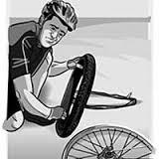
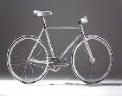
Inductive reasoning
Also called bottom-up logic
It is the reverse of deductive reasoning
This method
  begins with specific pieces of information or observations,
  and then it concludes with a generalization
  the generalization that may or may not be factual
My bicycle has a flat tire
My bicycle is silver
Therefore, all silver bicycles have flat tires

Slide 39

Limited experiences to sweeping generalities!!!
Every fire hydrant in my neighborhood is red
Every fire hydrant in my best friend’s neighborhood is red
Therefore, every fire hydrant in town is red !!!!

Slide 40
Another example
Observation:
Sheela is seen walking from her car to her home with a set of golf clubs
Observation:
Sheela’s husband Jeff loves golf and tomorrow is his birthday
Conclusion (inference):
Sheela has bought the set of golf clubs for Jeff

Slide 41
The risk of uncertainty
Inductive reasoning depends on human observation
Whereas, deductive reasoning drives you to a conclusion based on known facts
Sheela, after all, may be borrowing the golf clubs. Or she may have taken up golf herself!
You wouldn’t know unless you observed carefully, and even then, you would have to describe your conclusion as “probable” but not firm

Slide 42
Premises of inductive arguments
The premises of inductive arguments
  do not prove their conclusions,
  but rather they support them
The strength of the argument depends on how much support the premise provides the conclusion
The less support it provides, the weaker the argument
The more support it provides, the stronger the argument

Slide 43
Create a logical conclusion based on the following examples of inductive reasoning. Then decide whether the reasoning is sound.
This green jellybean tastes like spearmint. This green jellybean tastes like spearmint too. Therefore…
I saw a man on a unicycle in the park last Sunday.
I saw a man on a unicycle in the park this Sunday too. Therefore, next Sunday…

Slide 44
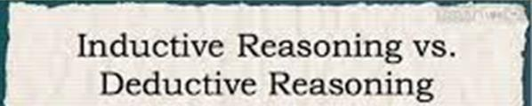


Kim knows that Alex is a sophomore(II year) and Kevin is a Junior
All the other juniors that Kim knows are older than Alex
Therefore, Kim reasons inductively that Kevin is older than Alex based on past observations
Kim knows that Kevin is older than Mia
She also knows that Mia is older than Alex
Therefore, Kim reasons deductively that Kevin is older than Alex based on accepted statements

Slide 45
Deductive and inductive in real world???
This risk of uncertainty in inductive reasoning is why crime scene investigators must ensure that they have gathered many observations (evidence) before drawing a conclusion
However, here’s something interesting
  Once CSI’s have biological evidence of a person at the scene, they can switch back to deductive reasoning
  If it is a known fact that someone’s fingerprints or DNA identify him or her, then it can be deduced that fingerprint or DNA evidence at the scene proves the person was there
So that’s it. Deductive and inductive. It takes both types of reasoning help us move around this world.

Slide 46
A conversation
Adham: I've noticed previously that every time I kick a ball up, it comes back down, so I guess this next time when I kick it up, it will come back down, too
Rizik:That's Newton's Law
Everything that goes up must come down
And so, if you kick the ball up, it must come down
Adham: I've noticed previously that every time I kick a ball up, it comes back down, so I guess this next time when I kick it up, it will come back down, too

Slide 47
from
Adham is observation
using
inductive
reasoning,
arguing
Rizik:That's Newton's Law
Everything that goes up must come down
And so, if you kick the ball up, it must come down
Rizik is using deductive reasoning, arguing from the law of gravity

Slide 48
Rizik's argument is clearly from the general (the law of gravity) to the specific (this kick)
Adham's argument may be less obviously from the specific (each individual instance in which he has observed balls being kicked up and coming back down) to the general (the prediction that a similar event will result in a similar outcome in the future) because he has stated it in terms only of the next similar event-- the next time he kicks the ball

Slide 49

Good logical arguments can come in two varieties:
deductive demonstrations
inductive supporting arguments
49
Department of CSE

Slide 50
State whether Deductive or Inductive
All cats have fur.
Xena is a cat.
Therefore, Xena has fur.
. Some horses are big.
All horses have tails.
Therefore, anything with a tail is big.
All humans have a nose.
Bobby is human.
Therefore, Bobby has a nose.

Slide 51
State whether Deductive or Inductive--- soln
D
All cats have fur.
Xena is a cat.
Therefore, Xena has fur.
I
Some horses are big.
All horses have tails.
Therefore, anything with a tail is big.
D
All humans have a nose.
Bobby is human.
Therefore, Bobby has a nose.

Slide 52
State whether Deductive or Inductive
This marble from the bag is black. That marble from the bag is black. A third marble from the bag is black. Therefore all the marbles in the bag black.
Sam is a bus driver. All drivers drive at 30km an hour, therefore Sam drives at 30 km an hour.
Every time you eat peanuts, your throat sweels up and you can't breath. So, you are allergic to peanuts.
All cats that you have observed purr.Therefore, every cat must purr.
To get a Bachelor's degree at Utah Sate University, a student must have 120 credits. Sally has more than 130 credits. Therefore, Sally has a bachelor's degree.
Bachelor's are unmarried men. Bill is unmarried. Therefore, Bill is a bachelor
52
Department of CSE

Slide 53
State whether Deductive or Inductive (Soln)
This marble from the bag is black. That marble from the bag is black. A third marble from the bag is black. Therefore all the marbles in the bag black.(Inductive)
Sam is a bus driver. All drivers drive at 30km an hour, therefore Sam drives at 30 km an hour.(Inductive)
Every time you eat peanuts, your throat swells up and you can't breath. So, you are allergic to peanuts. (Inductive)
All cats that you have observed purr.Therefore, every cat must purr.(Inductive)
To get a Bachelor's degree at Utah Sate University, a student must have 120 credits. Sally has more than 130 credits. Therefore, Sally has a bachelor's degree.(Deductive)
Bachelor's are unmarried men. Bill is unmarried. Therefore, Bill is a bachelor.(Deductive)
53
Department of CSE

Slide 54
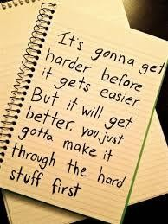
Case study time …..
54
Department of CSE

Slide 55
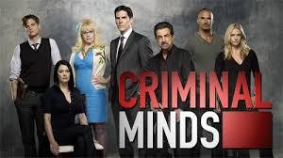
The show : Criminal Minds
The show Criminal Minds features a special unit of the FBI that profiles criminals
They do this by interviewing criminals who have already been caught and then inducing general rules about all criminals in order to catch the one they are looking for
Inductive reasoning, which uses specific examples to make a general rule, can be seen frequently in episodes of TV shows or movies that involve crime scene investigation

Slide 56

A conversation among the profilers
Hotch: Sprees usually end in suicide. If he’s got nothing to live for, why wouldn’t he end it?
Reid: Because he’s not finished yet.
Reid: He’s obviously got displaced anger and took it out on his first victim.
Hotch: The stock boy represented someone.We need to know who.What about the other victims.
Reid: Defensive.

Slide 57
Hotch: Was he military?
Garcia: Negative.
Hotch: He’s lashing out.There’s got to be a reason. Rossi and Prentiss, dig through his house. Reid and JJ, get to the station. Morgan and I will take the crime scene.This guy’s got anger, endless targets and a gun. And from the looks of it, he just got started.
What does the conversation lead to?

Slide 58
Solution:
The conversation leads to inductive reasoning
Conversations among the profilers, like the one above, lead to inductive reasoning that can be summed up as follows:
He has nothing to live for.
He doesn’t want to commit suicide.
He wasn’t in the military.
He has displaced anger.
He has endless targets.
He has a gun.
He is a dangerous man who will hurt more people. (conclusion)

Slide 59
Case study time …..
59
Department of CSE

Slide 60
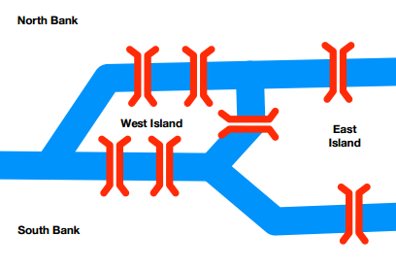
Bridges of Königsberg
In the city of Königsberg, there is a river that forms two islands namely West Island(WI) and East Island(EI). Two banks of the river – North Bank(NB) and South Bank(SB) - are connected to these island by means of seven bridges as shown in the map above. Is it possible to start from any one of the four points (WI,EI,NB or SB) in the city, visits each part of the city (both banks and both islands), crosses each bridge once and come back to the starting point? There is no restriction in visiting land areas multiple times.
60
Department of CSE

Slide 61
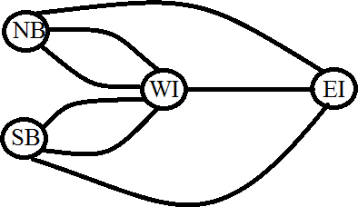
Bridges of Königsberg : Solution
Let us start by representing the map
Circles represent land area and black lines represent bridges.
Let us start with North Bank(NB)
Whenever we cross one bridge, we will change its colour to RED
61
Department of CSE

Slide 62
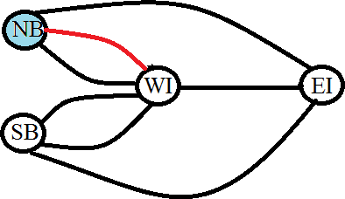
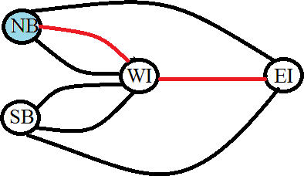
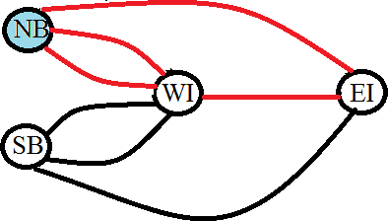
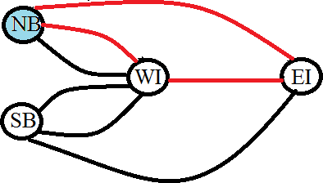
Now there is no bridges (which we have not crossed) available to take us
back to North Bank!!!
Try with some other starting point and see
Are you able to achieve the goal?
What do you observe in each case?
62
Department of CSE

Slide 63
If we are returning back to the starting point, we have not crossed all bridges → there will be some black lines
If we have crossed all bridges; i.e.; all lines are re-coloured as RED, we will be in a land area that is different from our starting point
Hence, the conclusion is that it is not possible to start from any one of the four points (WI,EI,NB or SB) in the city, visits each part of the city (both banks and both islands), crosses each bridge once and come back to the starting point
63
Department of CSE

